Slide 1

Deputy Governor Briefing
S4 Guardian V3
National public safety operating system for emergency reporting, AI triage, responder routing, camera handoff, and accountable government action.
Citizen safety
Responder coordination
Privacy vault
7
1
Product surfaces
Emergency lifecycle
S4 Guardian V3
01

Slide 2
POSITIONING
S4 is not an app. It is the state safety layer between citizens and response institutions.
The platform connects the moment of fear to the moment of accountable response.
Citizen
AI Triage
Command
Report danger, attach evidence, hide in stealth mode, track case disclosures.
Classify emergency, score severity, extract plates/weapons/location, route events.
See incidents, teams, command centers, routes, evidence requests, and transfers.
Responder
Oversight
Receive dispatch, stream telemetry, navigate, arrive, resolve, and close.
Audit identity access, evidence downloads, risk alerts, and responder performance.
S4 Guardian V3
02

Slide 3
FAILURE S4 FIXES
The old public safety model loses time, trust, and evidence at every handoff.
S4 converts fragmented signals into a live, reviewable operating picture.
Latency
Trust gap
Blind pursuit
No memory
Citizens report through scattered channels. Dispatchers manually interpret incomplete context.
Victims and whistleblowers fear identity exposure or retaliation after reporting.
Responders chase last known locations instead of predicted movement and next camera context.
Evidence, plates, actions, and decisions are not one case timeline.
S4 Guardian V3
03

Slide 4
CITIZEN APP
The S4 citizen flow is built for panic, coercion, poor connectivity, and trust.
These are the real citizen-side controls in the current app.
Verify & Continue
Safety Hub
NIN, name, phone, PIN
Fire, Armed Robbery, Accident, Medical, Kidnapping, Other
Live Photo
Voice Note
Attach image evidence
Capture spoken context
Live Video
Send Emergency Report
Attach video evidence
Submit to Gemini triage
I'm Safe - Cancel Alert
Case Monitor
Close accidental or resolved alert
Track status and vault disclosures
Upload Evidence
Stealth
Respond to evidence request
Calculator, weather, settings, math decoy triggers
S4 Guardian V3
04

Slide 5
SCENARIO: ARMED ROBBERY
A citizen sees armed assailants entering a vehicle. S4 turns a panic report into coordinated action.
The system captures location, evidence, plate clues, severity, responder assignment, and audit memory.
01
02
03
04
05
Report
Triage
Route
Dispatch
Audit
Citizen selects Armed Robbery, attaches photo/voice/video.
Gemini scores severity and extracts vehicle plate if present.
Nearest command center receives the incident.
Responder patrol receives active route and telemetry link.
Identity access, evidence downloads, and actions become case memory.
S4 Guardian V3
05

Slide 6
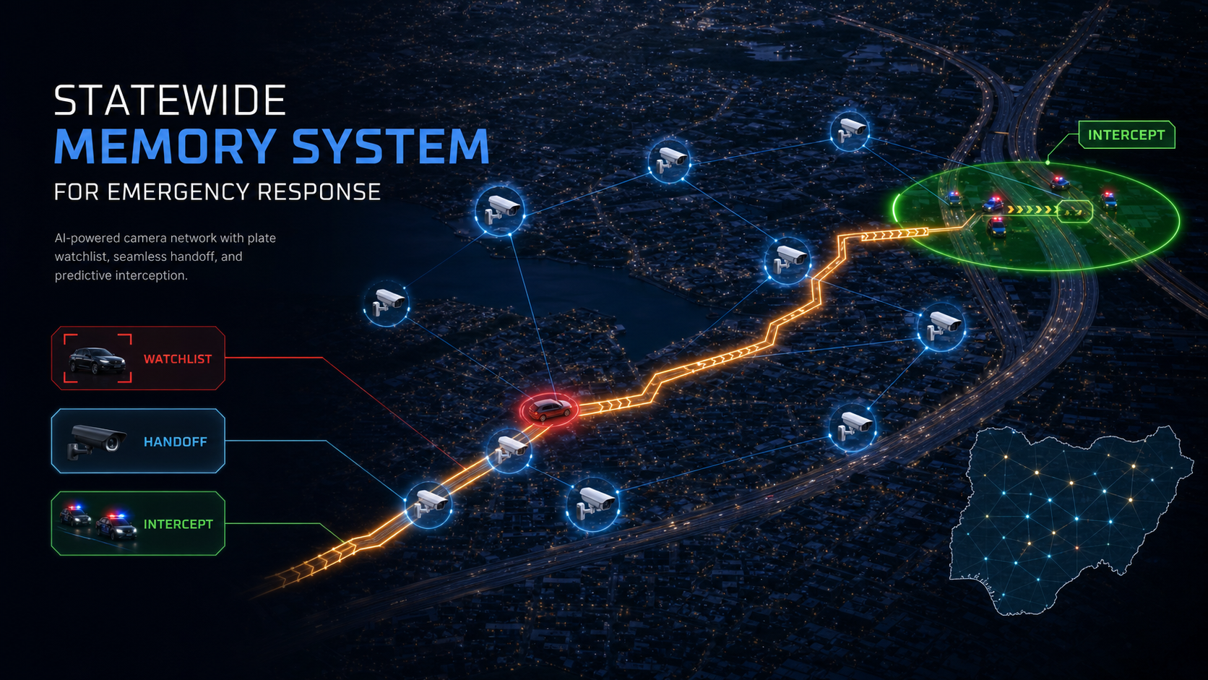
Scenario: Vehicle Memory
A plate spotted today stays alive until the case is resolved.
If LND-419LA appears 400km away later, S4 reconnects the sighting to the same incident, the same timeline, and the same accountable response record.
Watchlist does not forget
Every sighting adds evidence
S4 Guardian V3
06

Slide 7
DISPATCH DASHBOARD
The dispatcher sees active incidents, Gemini analysis, identity vault controls, and FRSC vehicle lookup.
These are the exact controls that make S4 operational, not theoretical.
Panic Simulation Console
Incident Details
Submit Panic Report to Triage
View GPS, status, severity, and AI summary
PII Identity Vault Access
Road Department Vehicle Lookup
Verify PIN & Reveal Identity with reason
Query FRSC using extracted or typed plate
Detected plate hint
Compliance result
Gemini extracted plate number appears automatically
Citizen is notified when identity is decrypted
S4 Guardian V3
07

Slide 8
COMMAND CENTER
S4 gives the state a live map, dispatch feed, responder telemetry, and escalation controls.
This is where policy becomes operational command.
Track Location
Assign Responder Patrol
Open a critical panic event on the map
Send idle patrol car to the incident
Route / Re-Route Command Center
Request More Evidence
Transfer incident to Police, FRSC, Fire, or Ambulance station
Ask citizen for additional photo, video, or context
Locate User / Search
Strategic Dispatch Feed
Center map on GPS or command locations
Review all active and resolved incident movement
S4 Guardian V3
08

Slide 9
RESPONDER TERMINAL
Responder vehicles become live field nodes, not disconnected patrol cars.
S4 closes the loop from dispatch to arrival to resolution.
Select Responder Vehicle Unit
Dispatch Order Incoming
Pair the in-car browser terminal to a patrol team
View incident type, threat level, location, and description
Simulate Driving
Arrive on Scene
Stream coordinate telemetry toward incident
Confirm GPS arrival at the incident
Resolve & Close Incident
Radio Broadcast & Telemetry Logs
Close dispatch and return unit to idle
Keep a timestamped operational feed
S4 Guardian V3
09

Slide 10
TRACK ME
S4 predicts the next useful interception point instead of just showing the last dot.
Responder GPS, incident GPS, camera timestamps, plate sightings, speed, and heading become movement intelligence.
Speed
Next camera
Computed from responder GPS and camera timestamp differences.
Camera hit
Direction
Projected from last known heading and road graph.
Crime
Next camera
Block point
Prioritizes cameras likely to see the vehicle next.
Block point
Recommends safer responder interception zones.
S4 Guardian V3
10

Slide 11
CAMERA HANDOFF
Citizen and government cameras become a lawful thinking layer for public safety models.
S4 can register cameras, validate ownership, request incident-relevant frames, and hand context across the camera graph.
01
02
03
04
05
Register
Verify
Watch
Handoff
Audit
Owner adds camera location, type, and access policy.
Government validates identity, consent, and camera metadata.
Incident watchlist tells relevant cameras what to look for.
Next camera receives context from previous sighting.
Every access, alert, and model decision is logged.
S4 Guardian V3
11

Slide 12
PRIVACY VAULT
S4 protects citizens by separating emergency facts from personal identity.
Operational responders get what they need. Identity access requires justification, PIN verification, notification, and audit.
Operational incident
Identity vault
Reveal workflow
Citizen notice
Type, GPS, severity, evidence metadata, status, command center, responder team.
Name, phone, contacts encrypted with AES-256-GCM and separated from incident data.
Officer PIN plus access reason required before identity can be decrypted.
Citizen is notified and can later review disclosure history.
Governance advantage: the state can review what happened, what the model believed, who acted, and why.
S4 Guardian V3
12

Slide 13
OFFLINE AND SMS RESILIENCE
S4 is designed for real Nigerian failure modes: network loss, coercion, and congested infrastructure.
Reports can be queued locally, synced later, or compiled into a structured SMS emergency message.
01
02
03
04
05
Online
Offline queue
SMS fallback
Webhook
Sync
Submit directly to incident API with GPS and evidence.
Save unsent report in local storage.
Build [S4 EMERGENCY] message with type, info, location, and sender.
Gateway parses SMS into incident plus identity vault record.
When online, queued reports upload and clear safely.
S4 Guardian V3
13

Slide 14
OVERSIGHT AND ACCOUNTABILITY
S4 produces the evidence trail government needs after the emergency ends.
Every action becomes structured data for performance review, legal review, and institutional trust.
Incident creation
Gemini triage
Responder assignment
Camera sighting
FRSC lookup
Identity reveal
Evidence download
Case resolution
Nothing important disappears into phone calls, private chats, or unverifiable verbal instructions.
S4 Guardian V3
14

Slide 15
EXAMPLE: ONE SENTENCE BECOMES AN OPERATIONAL CASE RECORD.
Input: "Two armed men entered a silver Corolla, plate LND-419LA, heading toward Aba Road."
S4 is designed to convert ordinary human language into the structured fields government responders need.
Human report
AI interpretation
System record
A citizen gives messy text, voice, image, or video evidence while GPS and device context are captured.
Gemini classifies ARMED_ROBBERY, estimates severity, extracts LND-419LA, and summarizes the threat.
Incident type, severityScore, GPS, status, detectedPlateNumber, evidence metadata, commandCenterId, responderTeamId.
The important point: S4 does not store a vague complaint. It creates an actionable, reviewable case object.
S4 Guardian V3
15

Slide 16
EXAMPLE: FRSC VEHICLE LOOKUP TURNS A PLATE CLUE INTO USABLE FIELD INTELLIGENCE.
If Gemini extracts LND-419LA, the dispatcher can query the Road Department / FRSC-style registry without leaving the case.
Operator sees
Responder uses
System remembers
Governance holds
Plate, make, model, color, registration status, owner record, and any crime-involvement flag.
A patrol unit can look for a specific vehicle signature, not just "a car heading that way."
Plate, color, make, confidence, and lookup metadata stay attached to the same incident timeline.
The lookup is part of an official case record, not a private, unreviewable search.
This is where S4 becomes practical for vehicle-enabled crimes: robbery, kidnapping, hit-and-run, convoy threats, and stolen vehicles.
S4 Guardian V3
16

Slide 17
TRACK ME: FROM LAST KNOWN LOCATION TO PREDICTED INTERCEPTION.
Example: Camera A sees a vehicle at 14:03. Camera B sees the same plate at 14:07. S4 estimates speed, direction, next camera, and block point.
Speed
Direction
Next camera
Block point
Distance between sightings divided by time gives estimated travel speed.
The sequence of camera hits and road graph suggests heading, not just a single dot.
S4 ranks cameras most likely to see the vehicle next based on trajectory.
Responder receives safer interception guidance instead of chasing the previous sighting.
Input
Compute
Output
A+B hits
Movement
Intercept
Plate, timestamp, camera location, confidence.
Speed, heading, likely next road segment.
Responder block point and audit log.
S4 Guardian V3
17

Slide 18
CAMERA REGISTRATION: PUBLIC SAFETY WITHOUT UNLIMITED CAMERA ACCESS.
A shop, estate, school, clinic, or traffic camera can become part of the safety mesh with ownership, consent, revocation, and audit.
01
02
03
04
05
Register
Verify
Request
Handoff
Review
Owner adds location, camera type, and emergency access policy.
Government validates owner, camera identity, and consent.
Only incident-relevant frames or alerts are requested.
Camera context transfers to the next likely camera.
Every request, match, and model action is auditable.
This lets government scale visibility using citizen infrastructure while preserving consent and reviewability.
S4 Guardian V3
18

Slide 19
EVIDENCE AND AUDIT: EVERY IMPORTANT ACTION BECOMES DATA THE STATE CAN RELY ON.
S4 is built so response speed, citizen trust, and legal defensibility reinforce each other.
Report submitted
Gemini classified
FRSC queried
Unit dispatched
Camera matched
Identity revealed
Evidence downloaded
Case resolved
For command
For oversight
For policy
What happened, where, and who responded.
Who accessed identity or evidence, and why.
Where bottlenecks and repeat threats appear.
S4 Guardian V3
19

Slide 20
PILOT PLAN
Start with one high-visibility corridor and prove the operating model in 90 days.
S4 can begin narrow, measurable, and politically defensible.
Phase 1: Corridor setup
Phase 2: Citizen + dispatcher demo
Phase 3: Camera + Track Me
Onboard command centers, responder teams, agency users, and emergency categories.
Launch reporting, triage, identity vault, evidence requests, FRSC lookup.
Register cameras, activate plate watchlists, handoff, speed prediction, intercept suggestions.
90 days
Police + FRSC
Response trust
Safety memory
Pilot window
Primary agencies
Core measure
Public value
S4 Guardian V3
20

Slide 21
Decision Ask
Approve S4 Guardian V3 as the pilot public safety operating system.
The state gets faster response, better coordination, citizen trust, live camera intelligence, privacy-preserving identity access, and an evidence trail that survives scrutiny.
What to approve
What to measure
90-day corridor pilot with command, responder, citizen, and camera onboarding.
Response speed, case completion, disclosure integrity, citizen confidence.
S4 Guardian V3
21

