Slide 1

Deputy Governor Briefing
Guardian AI
Emergency response with speed, privacy, and accountability.
A state-ready operating system for citizen panic reporting, AI triage, responder routing, privacy vaulting, and evidence oversight.
Citizen
Dispatch
Responders
Oversight

Slide 2
THE CASE FOR ACTION
The state does not need another hotline. It needs a trusted response loop.
Guardian AI closes three gaps that delay response and weaken public confidence.
Speed
Trust
Control
AI triage turns citizen reports into structured incidents.
Identity remains sealed until justified and audited access.
Command sees incidents, routes, responder state, and evidence.
Guardian AI V3
02

Slide 3
THE PRODUCT
One platform connects the entire emergency response lifecycle.
Citizen Safety Hub
Emergency Triage Queue
Oversight vault
FIRE
MEDICAL
Armed robbery
9.2
Incident Details
Access logs
Hash verification
Evidence links
Court brief export
Citizen disclosures
ROBBERY
OTHER
6.8
AI analysis
GPS location
PII vault access
Vehicle lookup
Accident
Suspicious vehicle near Yaba...
Medical
5.1
Reveal Identity
SEND EMERGENCY REPORT
GPS + evidence + vault
Verify Chain
Stealth
Cases
Guardian AI V3
03

Slide 4
OPERATING MODEL
A panic report becomes an accountable public safety action.
01
02
03
04
05
Citizen
AI triage
Command
Responder
Oversight
Reports danger with GPS and evidence.
Scores severity and extracts signals.
Routes, assigns, and requests evidence.
Updates status and requests vault access.
Verifies logs and prepares evidence.
The design principle is simple: operational data moves fast; identity data remains protected.
Guardian AI V3
04

Slide 5
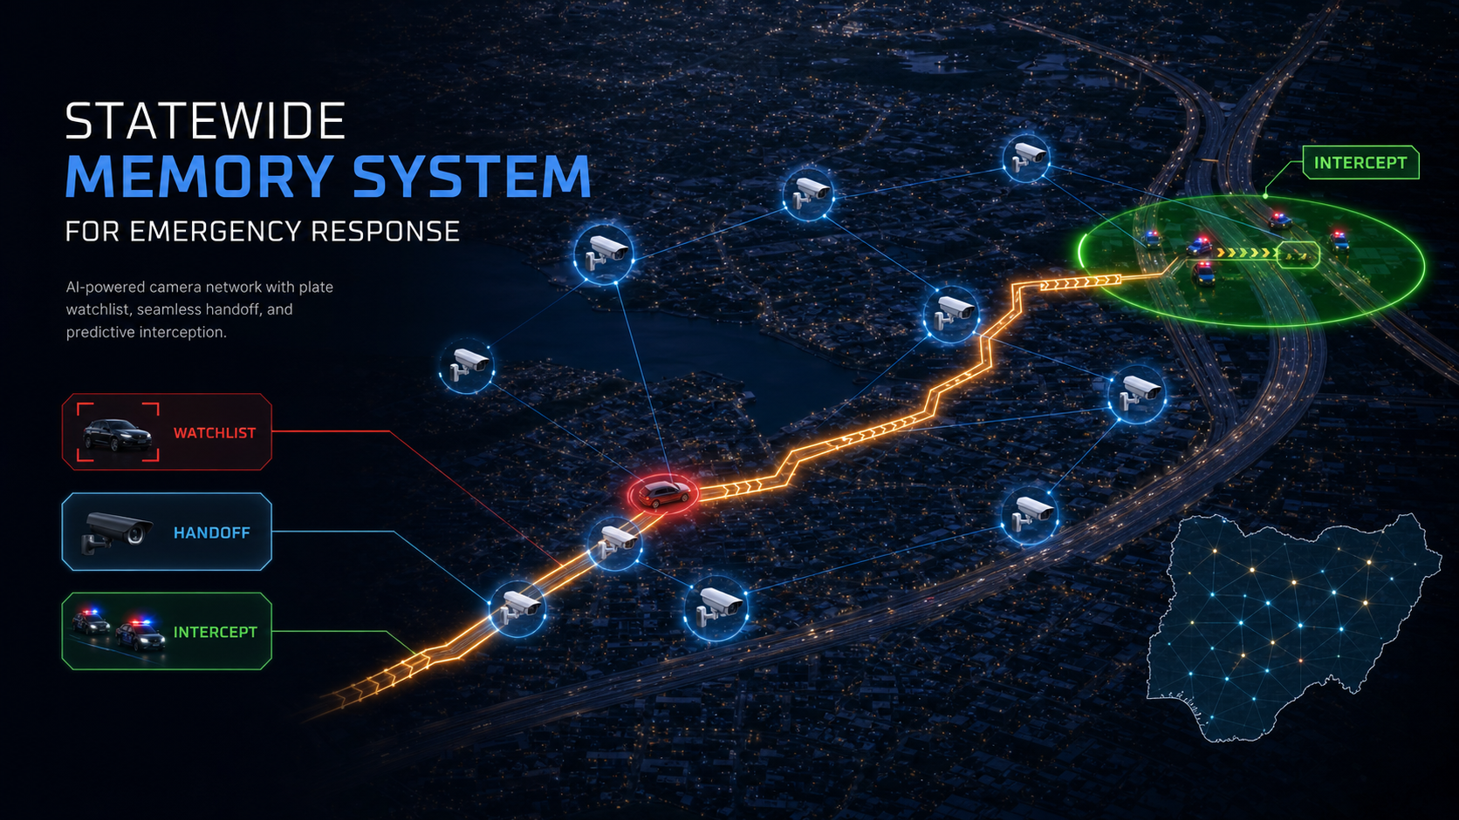
Scenario 01
A crime is reported. A car is identified. S4 turns the plate into statewide memory.
The model alerts cameras in the crime area first, then preserves the plate and vehicle signature so a camera 400km away can still reconnect the case.
Nothing is forgotten until resolved
Every sighting becomes evidence

Slide 6
SCENARIO: SUSPECT VEHICLE
From one plate read to a statewide watchlist in seconds.
This is the S4 + Vigil memory loop for a stolen vehicle, kidnapping vehicle, robbery car, or fleeing suspect.
01
02
03
04
05
Crime report
Plate memory
Camera alert
Hand-off
Intercept
Citizen / officer files incident
LND-419LA becomes active watchlist
Nearby cameras watch for car
Next camera inherits context
Responder blocks predicted path
Case memory stays live: plate, make, color, last camera, direction of travel, confidence, officer actions, citizen evidence, and resolution status.
Guardian AI V3
06

Slide 7
SCENARIO: TRACK ME
S4 can track travel speed and predict where responders should block the assailants.
The responder does not chase a dot. The system estimates likely next camera, road segment, and intercept point.
Predictive interception
FRSC
Speed
Computes travel speed from GPS and camera timestamps.
HQ
Direction
Projects path using road graph and last known heading.
Panic
Next camera
Prioritizes cameras likely to see the vehicle next.
Unit
Block point
Suggests safest responder interception zone.
Guardian AI V3
07

Slide 8
SCENARIO: CITIZEN CAMERA HANDOFF
Citizens can register cameras into a government-run safety mesh.
Registered cameras become a lawful handoff layer and context layer for the models, with consent, audit, and revocation controls.
Citizen registration flow
Estate
Register Camera
Owner adds location, camera type, and access policy.
Shop
School
Verify Ownership
Government validates consent and camera identity.
Emergency Hand-off
Only incident-relevant frames are requested or analyzed.
Street
The model does not depend on one camera. It reasons across a trusted camera graph.
Clinic
Guardian AI V3
08

Slide 9
S4 + VIGIL TECHNOLOGY
Vigil gives S4 the vision layer: detection, handoff, tracking, and memory.
The deck can credibly say this because Vigil already includes the architecture for RTSP analysis, LPR, tracking, sensor fusion, and tiered vision reasoning.
LPR
Multi-camera handoff
Naija plate parsing, OCR ambiguity handling, whitelist/watchlist matching.
RTSP workers, object detection, embeddings, track manager, event aggregation.
Trajectory intelligence
Vision reasoning
Speed, heading, last seen, predicted next camera, and intercept suggestion.
Tiered model router: cheap confirmation, premium narrative, report generation.
Guardian AI V3
09

Slide 10
CASE MEMORY
Nothing gets forgotten until the incident is resolved.
Every report, camera hit, operator action, responder movement, and identity access becomes structured data the state can rely on.
Report
Plate
Camera hit
Speed
Prediction
Responder action
Vault access
Resolution
This is the governance advantage: the state can review what happened, what the model believed, who acted, and why.
Guardian AI V3
10

Slide 11
CITIZEN EXPERIENCE
The citizen flow is built for speed, discretion, and follow-up transparency.
Citizen Safety Hub
Core citizen controls
FIRE
MEDICAL
ROBBERY
OTHER
Verify & Continue
Checks citizen identity before reports are sent.
Fire, Robbery, Accident, Medical, Kidnapping, Other
Chooses the emergency type and preloads context.
Live Photo, Voice Note, Live Video
Adds evidence when it is safe to do so.
Suspicious vehicle near Yaba...
Stealth
Hides the app behind a decoy and can trigger silent panic.
Case Monitor
Shows status, evidence requests, and disclosure history.
SEND EMERGENCY REPORT
GPS + evidence + vault
Stealth
Cases
Guardian AI V3
05

Slide 12
COMMAND CENTER
A live map turns scattered reports into dispatch decisions.
Decision controls
FRSC
Track Location
Focus a critical alert on the map.
HQ
Dispatch Responder
Assign an idle patrol team.
Panic
Route Emergency
Transfer to police, fire, FRSC, or health.
Unit
Send Request
Ask the citizen for more evidence.
Search and Locate
Center on a command station or GPS position.
Guardian AI V3
06

Slide 13
PRIVACY VAULT
The platform separates emergency action from identity disclosure.
This is the trust layer a public sector deployment needs.
Incident data
Identity data
GPS, severity, incident type, responder assignment, evidence metadata.
PIN + reason + audit
Name, phone, trusted contacts, citizen disclosure history.
Guardian AI V3
07

Slide 14
RESPONDER TERMINAL
Field teams get action buttons, not bureaucracy.
Responder actions
Field intelligence
Why it matters
Authenticate
Logs officer into assigned unit.
Query
Checks vehicle plate registry.
Responders see the mission, update the state, and only unlock identity through a controlled workflow.
Arrive Scene
Updates status and telemetry.
Verify PIN & Decrypt
Reveals citizen PII when justified.
Resolve & Close
Marks case resolved.
Dismiss Alarm
Stops urgent alert audio.
Guardian AI V3
08

Slide 15
OVERSIGHT AND COURT READINESS
Every sensitive action can become a reviewable record.
Audit integrity
Evidence release
Court brief
Verify Chain
Detects tampered access logs.
Request Link
Generates protected download URL.
Reveal & Disclose
Adds identity to official brief.
Cryptographic Vault Logs
Shows who accessed identity.
Download File
Downloads evidence with tracking.
Export Official Court Brief
Prints the disclosure package.
Guardian AI V3
09

Slide 16
BUTTON APPENDIX
Citizen and case-monitor controls are covered for live demo readiness.
Citizen setup
Emergency report
After dispatch
Verify & Continue
Identity check.
Emergency categories
Set report type.
I'm Safe - Cancel Alert
Close active alert.
Settings
Profile, contacts, stealth codes.
Live Photo / Voice / Video
Attach evidence.
Case Monitor
Track status and disclosures.
Safety Hub
Return to reporting.
Send Emergency Report
Submit to triage.
Upload Evidence
Respond to evidence request.
Guardian AI V3
10

Slide 17
BUTTON APPENDIX
Operations controls move incidents from intake to response and evidence.
Dispatch
Command map
Responder
Incident card
Open details.
Track Location
Focus critical event.
Authenticate
Log in field unit.
Verify PIN & Reveal Identity
Access PII with audit.
Dispatch Responder
Assign team.
Arrive / Resolve
Update status.
Query FRSC
Vehicle lookup.
Route Emergency
Transfer agency.
Decrypt Citizen PII
Unlock only when justified.
Guardian AI V3
11

Slide 18
PILOT DESIGN
A controlled 90-day pilot can prove impact without overextending the state.
30 days
60 days
90 days
Connect one command center, agency users, citizen onboarding, and tabletop drills.
Run supervised reporting, responder telemetry, evidence requests, and vault audit reviews.
Publish readiness metrics, hotspot trends, response lessons, and expansion decision.
Decision requested: approve a multi-agency pilot with security, road safety, fire, health, justice, and digital governance representation.
Guardian AI V3
12

Slide 19
The ask
Authorize a controlled Guardian AI pilot to demonstrate faster response, protected identity, coordinated agencies, and auditable evidence.
Ready for approval review
Build-candidate deck
Guardian AI V3

